Slide 1
Acceleration of deep neural network

Slide 2
Objectives:
Define the accelerators on which models can run
Make comparison between accelerators
Define Deep Learning Frameworks
Make comparison between frameworks
Run each framework on each accelerators
Show runtime graphs

Slide 3
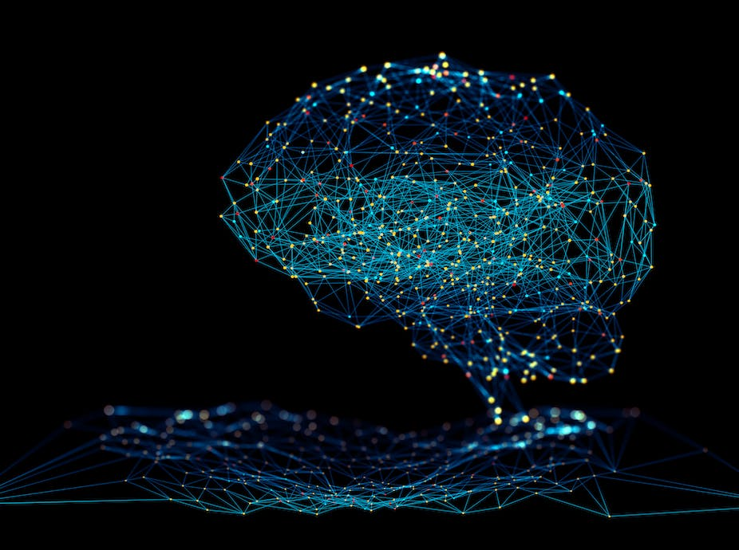
introduction
Artificial intelligence and machine learning technologies have been accelerating the advancement of intelligent applications. To cope with the increasingly complex applications, semiconductor companies are constantly developing processors and accelerators, including CPU, GPU, and TPU. However, with Moore's law slowing down, CPU performance alone will not be enough to execute demanding workloads efficiently.

Slide 4
The problem is, how can companies accelerate the performance of entire systems to support the excessive demands of AI applications? The answer may come via the development of GPUs and TPUs for supplementing CPUs to run deep learning models. That is why it is essential to understand the technologies behind CPU, GPU, and TPU to keep up with the constantly evolving technologies for better performance and efficiency.

Slide 5
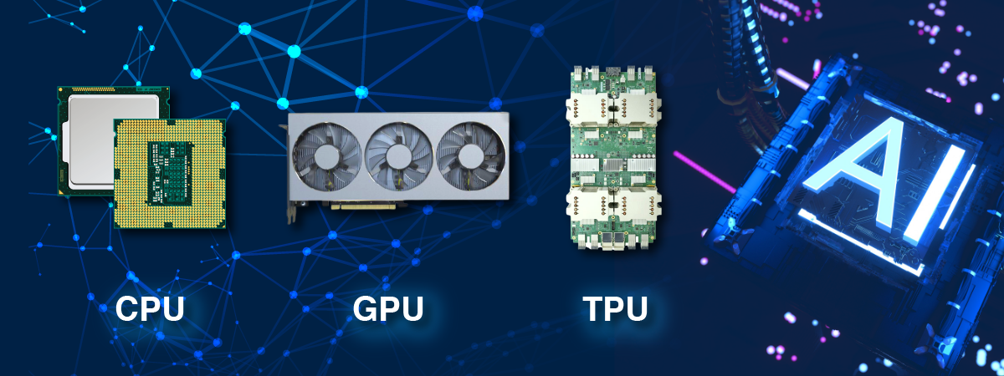
TPU vs GPU vs CPU Performance and Differences discussed
CPU or Central Processing Unit carries out all the arithmetic and logical operations. On the other hand, the work of a GPU is to render and process images or graphics. TPU is a special type of processor developed by Google. It is used to handle neural network processing using the TensorFlow. CPU can do multiple tasks, including image rendering. But the higher level of image rendering requires a dedicated processor, GPU. That’s why high-end games always require a dedicated graphics card.

Slide 6
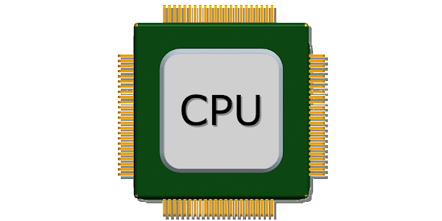
What is a CPU?
CPU stands for Central Processing Unit. It is the brain of a computer because it handles all the tasks that a user performs on his/her computer. All the arithmetic and logical calculations required to complete a task are performed by the CPU. The aim of the CPU is to take input from the devices connected to a computer like a keyboard, mouse, etc., or from a programming software and display the required output.

Slide 7
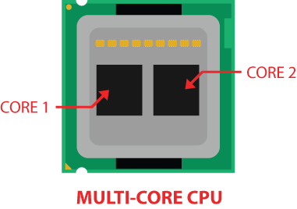
What are CPU Cores?
CPU cores are pathways consisting of billions of microscopic transistors. A CPU uses cores to process data. In simple words, a CPU core is a basic computation unit of a CPU. The number of cores is directly proportional to the computational power of a CPU. The CPU cores define whether the CPU can handle multiple tasks or not. You might have heard the following two types of CPUs:
Single-core CPU
Multi-core CPU

Slide 8
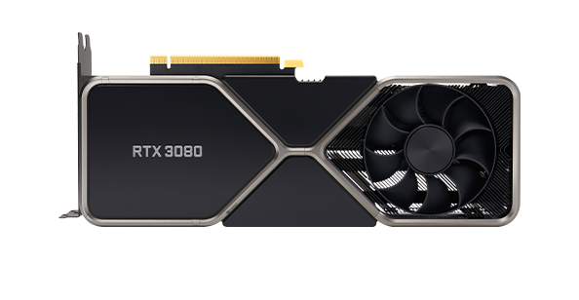
What is GPU?
GPU stands for Graphics Processing Unit. A GPU is used in a variety of applications, including image and video rendering. In the field of gaming, graphics cards have a crucial role. A GPU is the main component of a graphics card.
A GPU is a processor that is good at handling specialized computations.
This is in contrast to a central processing unit (CPU), which is a processor that is good at handling general computations. CPUs are the processors that power most of the typical computations on our electronic devices.

Slide 9
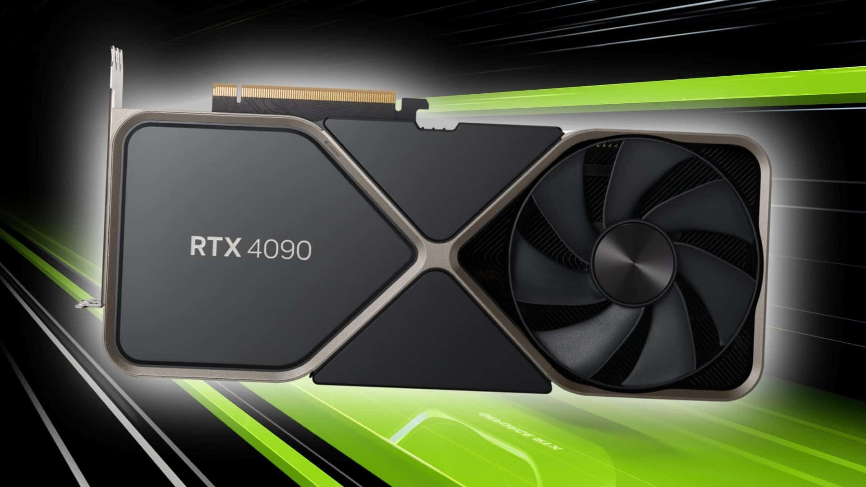
A GPU can be much faster at computing than a CPU. However, this is not always the case. The speed of a GPU relative to a CPU depends on the type of computation being performed. The type of computation most suitable for a GPU is a computation that can be done in parallel.
Parallel computing is a type of computation where by a particular computation is broken into independent smaller computations that can be carried out simultaneously. The resulting computations are then recombined, or synchronized, to form the result of the original larger computation.

Slide 10
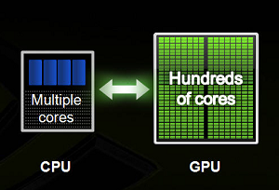
The number of tasks that a larger task can be broken into depends on the number of cores contained on a particular piece of hardware.
CPUs typically have four, eight, or sixteen cores while GPUs have potentially thousands.
In parallel computing, an embarrassingly parallel task is one where little or no effort is needed to separate the overall task into a set of smaller tasks to be computed in parallel.
Tasks that embarrassingly parallel are ones where it's easy to see that the set of smaller tasks are independent with respect to each other.
Neural networks are embarrassingly parallel for this reason. Many of the computations that we do with neural networks can be easily broken into smaller computations in such a way that the set of smaller computations do not depend on one another. One such example is a convolution.

Slide 11
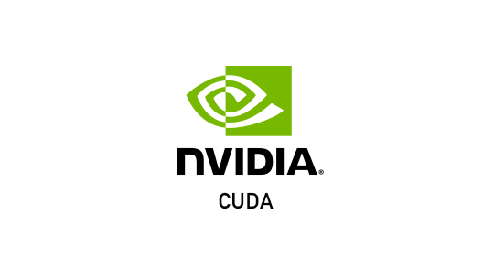
What is cuda?
Nvidia Hardware (GPU) And Software (CUDA)
This is where CUDA comes into the picture. Nvidia is a technology company that designs GPUs, and they have created CUDA as a software platform that pairs with their GPU hardware making it easier for developers to build software that accelerates computations using the parallel processing power of Nvidia GPUs.
CUDA is a parallel computing platform and application programming interface that allows software to use certain types of graphics processing units for general purpose processing, an approach called general-purpose computing on GPUs.
An Nvidia GPU is the hardware that enables parallel computations, while CUDA is a software layer that provides an API for developers.

Slide 12
As a result, you might have guessed that an Nvidia GPU is required to use CUDA, and CUDA can be downloaded and installed from Nvidia's website for free.
Developers use CUDA by downloading the CUDA toolkit. With the toolkit comes specialized libraries like cuDNN, the CUDA Deep Neural Network library.
The GPU is only faster for particular (specialized) tasks. One issue that we can run into is bottlenecks that slow our performance. For example, moving data from the CPU to the GPU is costly, so in this case, the overall performance might be slower if the computation task is a simple one.
Deep learning along with many other scientific computing tasks that use parallel programming techniques are leading to a new type of programming model called GPGPU or general purpose GPU computing.
GPGPU computing is more commonly just called GPU computing or accelerated computing now that it's becoming more common to perform a wide variety of tasks on a GPU.

Slide 13
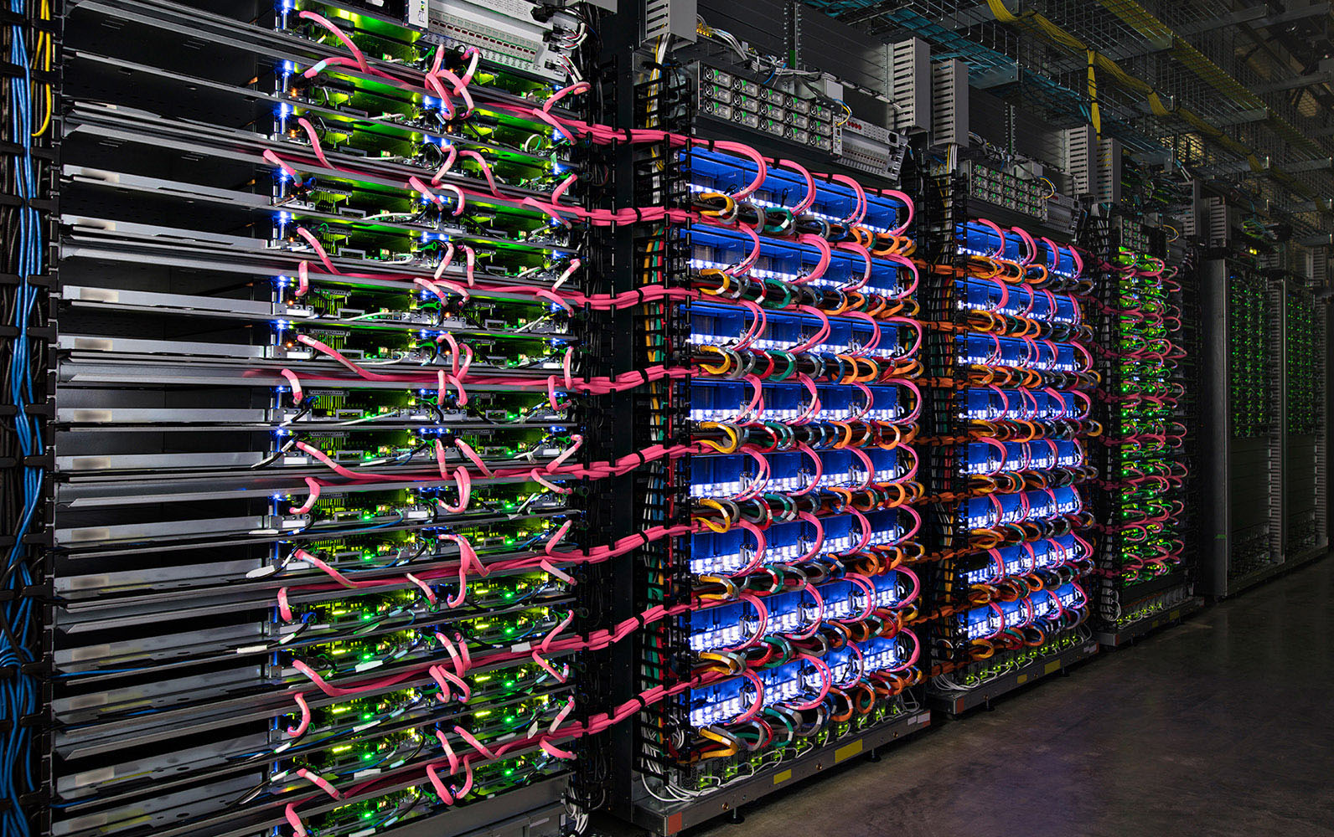
What is tpu?
TPU stands for Tensor Processing Unit. It is a processor developed by Google to handle neural network processing using the TensorFlow. TensorFlow is a free and open-source software library for artificial intelligence and machine learning.

Slide 14
The core of a TPU developed by Google is made of two units, namely, MXU (Matrix Multiply Unit) and VPU (Vector Processing Unit). The Matrix Multiply Unit performs matrix calculations and operates in a mixed 16 – 32-bit floating point format, whereas the Vector Processing Unit performs float32 and int32 computations.
Google has developed Cloud TPU to offer maximum flexibility and performance to researchers, developers, and businesses. The main aim to develop TPUs is to minimize the time required to train large and complex neural network models. The Cloud TPU accelerates the performance of linear algebra computation, which is used in machine learning applications. Due to this, TPUs are able to minimize the time to accuracy when it comes to training large and complex neural network models. If you train neural network models on hardware integrated with TPU, it will take hours, whereas, if the same task when done on the other hardware can take weeks.

Slide 15
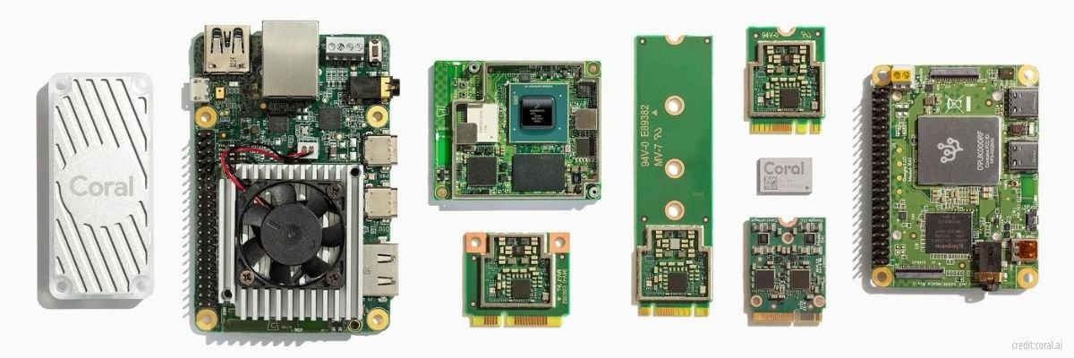
Google Coral
Google Coral is an edge AI hardware and software platform for intelligent edge devices with fast neural network inferencing. Coral is Google's initiative for pushing into Edge AI, with machine learning devices that run without a connection to the cloud.

Slide 16
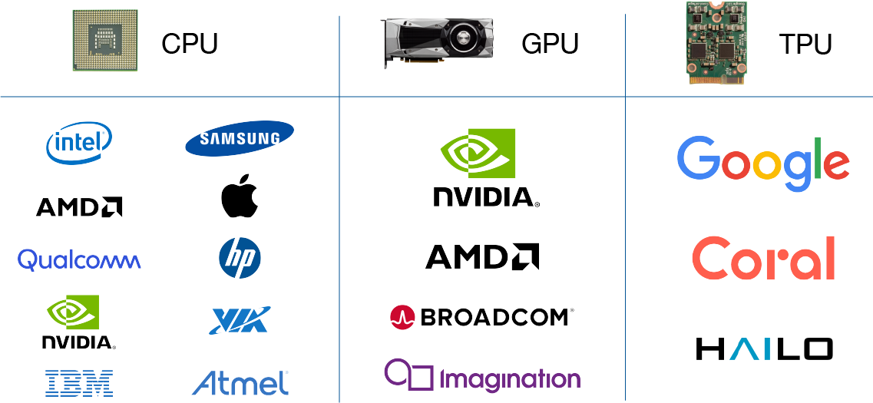
Let’s compare these three processors on different factors.

Slide 17
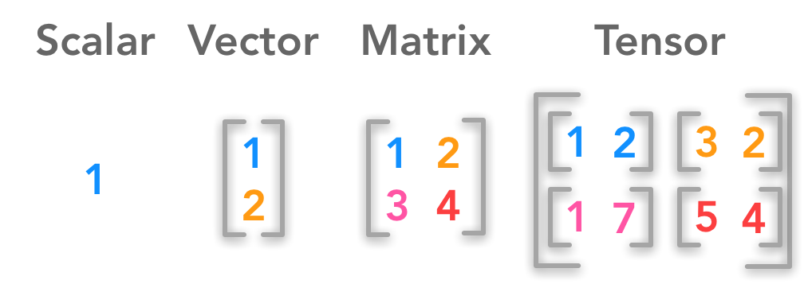
Cores
CPU (1x1): The number of cores in a CPU includes one (single-core processor), 4 (quad-core processor), 8 (Octa-core processor), etc. The CPU cores are directly proportional to its performance and also make it multitasking. The smallest unit of data handled at a time in CPU is a Scalar which is 1x1 dimensional data.
GPU (1xN): Unlike a CPU, a GPU has several hundred to several thousand cores. The calculations in a GPU are carried out in these cores. Hence, the GPU performance also depends on the number of cores it has. They can handle tens of thousands of operations per cycle, the dimension of data is generally 1 x N data unit.
TPU (NxN): According to Google, a single Cloud TPU chip has 2 cores. Each of these cores uses MXUs to accelerate the programs by dense matrix calculations. TPU can handle up to 128000 operations per cycle and the dimension of data are NxN data Unit.

Slide 18
Architecture
CPU: A CPU has three main parts, namely, CU, ALU, and Registers. Talking about the registers, there are 5 different types of registers in a CPU. These registers are:
Accumulator
Instruction Register
Memory Address Register
Memory Data Register
Program Counter

Slide 19
GPU: As explained above, there are several hundred to several thousand cores in a GPU. All the calculations required to perform image processing and image rendering are done in these cores. Architecturally, the internal memory of a GPU has a wide interface with a point-to-point connection.
TPU: TPUs are the Machine Learning accelerators designed by Google. Machine Learning accelerators have the potential to boost Machine Learning tasks. The cores of TPU comprise of MXU and VPU that are capable of carrying out the matrix and floating-point calculations respectively.

Slide 20
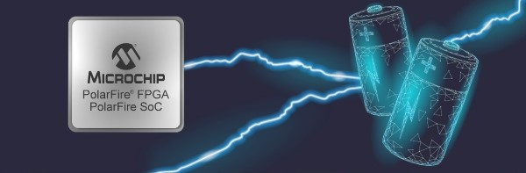
Power
CPU: The power consumed by a CPU depends on the number of cores it has. An Octa-core processor consumes power approximately from 95 to 140 watts, whereas a 16-core processor consumes approximately 165 watts of power.
GPU: A GPU can consume up to 350 watts of power.
TPU: In a TPU, the process of reading and writing is performed on buffer and memory due to which power optimization can be achieved.

Slide 21
The cache, the memory design and the entire architecture of the CPU are built around this purpose. CPUs are capable of processing tens of operations per cycle. It has an implicitly managed memory subsystem architecture and is produced by a bunch of manufactures. Data dimensions are usually 1 x 1 data unit.
The reason behind this is just the way a GPU is built. They can handle tens of thousands of operations per cycle, the dimension of data is generally 1 x N data unit, they have a mixed memory subsystem architecture and are produced by fewer, specialized manufacturers.
It has an explicitly managed memory subsystem architecture with data dimension of N x N data unit. This means that the TPU can handle up to 128,000 operations per cycle. That number isn’t even close to what the high-end CPUs and GPUs can manage.

Slide 22

What is tensorflow?
TensorFlow is an end-to-end open-source deep learning framework developed by Google and released in 2015. It is known for documentation and training support, scalable production and deployment options, multiple abstraction levels, and support for different platforms, such as Android.
TensorFlow is a symbolic math library used for neural networks and is best suited for dataflow programming across a range of tasks. It offers multiple abstraction levels for building and training models.
A promising and fast-growing entry in the world of deep learning, TensorFlow offers a flexible, comprehensive ecosystem of community resources, libraries, and tools that facilitate building and deploying machine learning apps. Also, as mentioned before, TensorFlow has adopted Keras, which makes comparing the two seem problematic. Nevertheless, we will still compare the two frameworks for the sake of completeness, especially since Keras users don’t necessarily have to use TensorFlow.

Slide 23

What is PyTorch?
PyTorch is a deep learning framework and a scientific computing package. This is how the PyTorch core team describes PyTorch, anyway. The scientific computing aspect of PyTorch is primarily a result PyTorch's tensor library and associated tensor operations.
A tensor is an n-dimensional array.
Tensors are super important for deep learning and neural networks because they are the data structure that we ultimately use for building and training our neural networks.
PyTorch: A Brief History
The initial release of PyTorch was in October of 2016, and before PyTorch was created, there was and still is, another framework called Torch. Torch is a machine learning framework that's been around for quite a while and is based on the Lua programming language.
The connection between PyTorch and this Lua version, called Torch, exists because many of the developers who maintain the Lua version are the individuals who created PyTorch.
PyTorch's design is modern, Pythonic, and thin. The source code is easy to read for Python developers because it's written mostly in Python, and only drops into C++ and CUDA code for operations that are performance bottlenecks.

Slide 24

What is JAX?
JAX is a framework for machine learning that allows you to use Python and NumPy to create and train neural networks. JAX is similar to other popular frameworks such as PyTorch and TensorFlow, but it has some unique features that make it a good choice for certain tasks.
Features of JAX:
Automatic Differentiation (AD):
JAX is based on the concept of "function transformations". This means that you can define a function, and then JAX will automatically compute the derivative of that function.
AD is a technique for efficiently computing the derivatives of functions. This is useful for a variety of tasks, such as optimizing neural networks and training machine learning models.
AD is typically performed using reverse-mode differentiation, which is a way of computing derivatives that is well-suited for deep learning. JAX implements reverse-mode differentiation using a technique called trace-based reverse-mode differentiation.
Just-in-time Compilation(JIT):
which is a technique for compiling code on the fly. JIT compilation can be used to improve the performance of numerical code, such as the code used in deep learning.
JAX uses a JIT compiler called XLA, which is also used by TensorFlow. XLA is a high-performance compiler that is able to optimize code for a variety of architectures, including CPUs, GPUs, TPUs, and custom hardware accelerators.
Memory Management:
JAX includes a number of features that help to manage memory usage. These features are particularly important for deep learning, which can require a large amount of memory.
JAX includes a number of memory management features, such as automatic garbage collection and reference counting. These features help to ensure that memory is freed when it is no longer needed.

Slide 25

JAX - FLAX, HAIKU, ELEGY.
There are six different JAX-based neural net libraries: Stax, Flax, Trax, Objax, Haiku, Elegy.

Slide 26
Increase The speed
In computing, just-in-time(Jit) compilation is a way of executing computer code that involves compilation during execution of a program rather than before execution. This may consist of source code translation but is more commonly bytecode translation to machine code, which is then executed directly.
XLA (accelerated linear algebra) is a compiler-based linear algebra execution engine. It is the backend that powers machine learning frameworks such as TensorFlow and JAX at Google, on a variety of devices including CPUs, GPUs, and TPUs. This talk will cover how ML growth has fueled accelerator architectures and the way XLA and related technologies help obtain high performance from the accelerators.

Slide 27
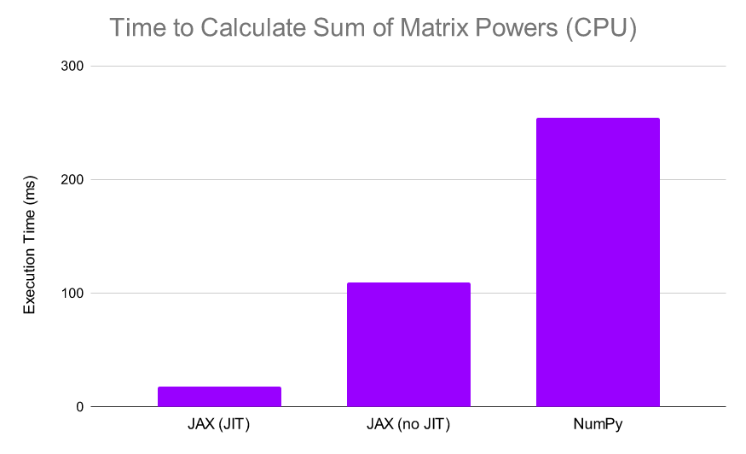
Example of using jit compiler

Slide 28
Steps to make a comparison:
In this project:
run different frameworks like:
Tnesorflow.
Pytorch.
JAX.
use different accelerators like:
CPU.
GPU.
TPU.
use benchmark dataset like MNIST dataset.
Integrate with only one configuration of Convolutional Neural Network.
Use the same hyperparameters in each notebook.

Slide 29
Dataset:
MNIST ( http://yann.lecun.com/exdb/mnist ) stands for Modified National Institute of Standards and Technology.
It contains labeled handwritten images of digits from 0 to 9.
The goal of this dataset is to classify handwritten digits.
MNIST has been popular with the research community for benchmarking classification algorithms.
In fact, it is considered the “hello, world!” of image datasets.
MNIST consists of 60,000 training images and 10,000 test images.
All are grayscale (one-channel), and each image is 28 pixels high and 28 pixels wide.

Slide 30
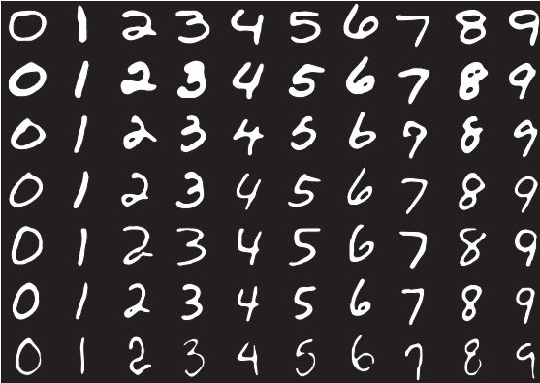
Figure 6.12 shows some sample images from the MNIST dataset.

Slide 31
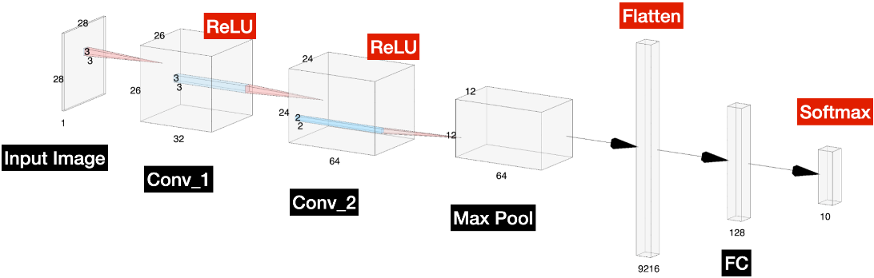
Convolutional Neural Network:

Slide 32

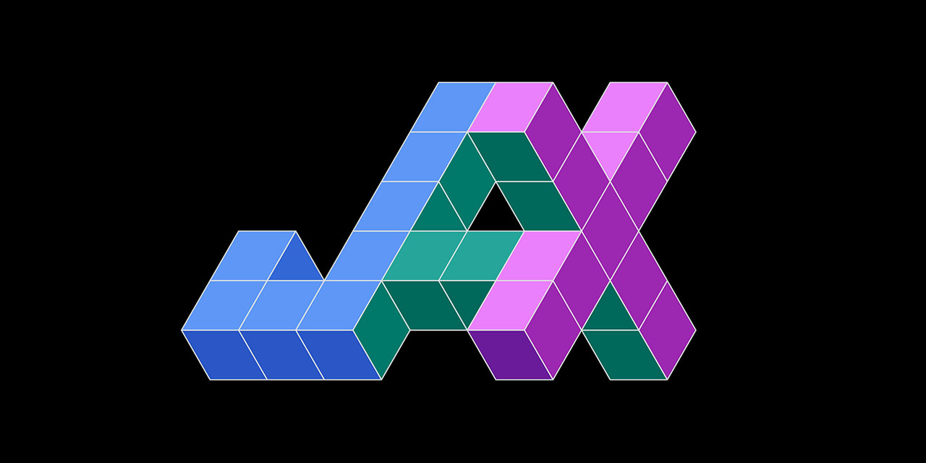
Showing results
Tensorflow runtime
Pytorch runtime
Jax runtime:
CPU:
TRAINING TIME: 1286.52 seconds
ACCURACY: 92.75%
GPU:
TRAINING TIME: 77.778 seconds
ACCURACY: 92.94%
TPU:
TRAINING TIME:
ACCURACY:
CPU:
TRAINING TIME: 3961.678 seconds
ACCURACY: 94.34%
GPU:
TRAINING TIME: 751.83 seconds
ACCURACY: 94.38%
TPU:
TRAINING TIME:
ACCURACY:
CPU:
TRAINING TIME:
ACCURACY:
GPU:
TRAINING TIME: 94.98 seconds
ACCURACY: 97.9%
TPU:
TRAINING TIME:
ACCURACY:

Slide 33
References:
https://premioinc.com/blogs/blog/what-is-the-difference-between-cpu-vs-gpu-vs-tpu-complete-overview
https://iq.opengenus.org/cpu-vs-gpu-vs-tpu/
https://www.kaggle.com/discussions/getting-started/340280
https://jax.readthedocs.io/en/latest/installation.html
https://github.com/TensorflowXLABeginner/XLA-Report/blob/master/FirstCommitReports/Accelerated%20Linear%20Algebra%20Intro.md
https://towardsdatascience.com/how-to-accelerate-your-pytorch-training-with-xla-on-aws-3d599bc8f6a9
https://www.kaggle.com/code/tanulsingh077/pytorch-xla-understanding-tpu-s-and-xla
https://pytorch.org/xla/release/1.13/index.html#creating-an-xla-tensor
https://medium.com/pytorch/get-started-with-pytorch-cloud-tpus-and-colab-a24757b8f7fc#:~:text=PyTorch%20uses%20Cloud%20TPUs%20just,as%20a%20different%20PyTorch%20device.&text=And%20tensors%20can%20be%20transferred%20between%20CPU%20and%20TPU.
https://github.com/pytorch/xla#how-to-run-on-tpu-vm-pods-distributed-training

